Slide 1

Operating system process scheduling algorithm
Group Members:
Zobia Khalid Malik (3355)
Fazila Bano (3504)
Syeda Kainat (3256)

Slide 2
“Shortest Burst High Priority”
Preemptive Or Non preemptive Nature:
Shortest Job Priority high is non preemptive process scheduling algorithm.
It executes the process till it’s burst time completes.
Algorithm:
First of all it takes the process which arrives first in ready queue whether its priority is low or high and burst time is low or high.
When two processes arrives in ready queue. Now there arrival time are same the comparison sifts from arrival time to burst .
During the first process execution completion time it will check how many process have arrived in ready queue then it will check for the lowest burst time process.

Slide 3

It will execute that process.
If in case two process have same burst time it will check their priorities if found one process with high priority than the other it will execute that process.
If the process arrival time, burst time and priority is same the FCFS will be applied.

Slide 4

Implementation:
#include<iostream>
using namespace std;
int main()
{
int bt[20],at[20],p[20],wt[20],tat[20],pr[20],i,j,n,total=0,pos,
temp,avg_wt,avg_tat;
cout<<"Enter Total Number of Process:";
cin>>n;
cout<<"\nEnter Arrival Time, Burst Time and Priority\n";
for(i=0;i<n;i++)
{
cout<<"\nP["<<i+1<<"]\n";
cout<<"Arrival Time:";
cin>>at[i];
cout<<"Burst Time:";
cin>>bt[i];
cout<<"Priority:";
cin>>pr[i];
p[i]=i+1; //contains process number
}

Slide 5

//sorting Arrival time, burst time, priority and process number in ascending order using selection sort
for(i=0;i<n;i++)
{
for(j=i+1;j<n;j++)
{
if(pr[j]>pr[pos]){
pos=j;
}
else if(pr[j]==pr[pos]){
for(j=i+1;j<n;j++)
{
if(bt[j]<bt[pos])
pos=j;
else if(bt[j]==bt[pos]){
if(at[j]<at[pos])
pos=j;
}
}
}
}

Slide 6

temp=at[i];
at[i]=at[pos];
at[pos]=temp;
temp=pr[i];
pr[i]=pr[pos];
pr[pos]=temp;
temp=bt[i];
bt[i]=bt[pos];
bt[pos]=temp;
temp=p[i];
p[i]=p[pos];
p[pos]=temp;
}
wt[0]=0; //waiting time for first process is zero
//calculate waiting time
for(i=1;i<n;i++)
{
wt[i]=0;
for(j=0;j<i;j++)
wt[i]+=bt[j];
total+=wt[i];
}

Slide 7
avg_wt=total/n; //average waiting time
total=0;
cout<<"\nProcess\t Burst Time \tWaiting Time\tTurnaround Time";
for(i=0;i<n;i++)
{
tat[i]=bt[i]+wt[i]; //calculate turnaround time
total+=tat[i];
cout<<"\nP["<<p[i]<<"]\t\t "<<bt[i]<<"\t\t "<<wt[i]<<"\t\t\t"<<tat[i];
}
avg_tat=total/n; //average turnaround time
cout<<"\n\nAverage Waiting Time="<<avg_wt;
cout<<"\nAverage Turnaround Time="<<avg_tat;
return 0;
}

Slide 8
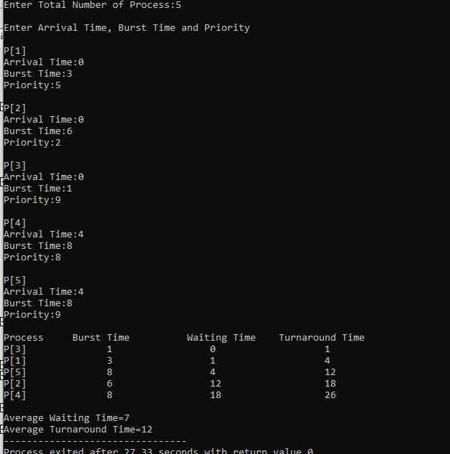
Output:

Slide 9
As you can see in the above provided processes p[3],p[2], p[1] arrives at 0.
Now the first executed process is p[3] has both shortest burst and high priority.
After that the p[1] executed on same condition as shortest burst and high priority.
After the completion of p[3], and p[2] all the processes arrived at unit time 4.
When all the processes arrived the first executed will be the last one because it arrive in the ready queue once it created.
After the last process completes again the processor checks the condition and the processes execute according to its condition.

Slide 10
Advantages | Disadvantages
The shortest process executes first and the average wait time and response time will be min. | It has basically no disadvantages because the algorithm has SJF and SRTF advantages but it removes the their disadvantages of SJF and SRTF.
2. The advantages are same as SJF and SRTF. | -
3. No Starvation due to double condition check. | -
4. Max processor utilization. | -
5. Max throughput. | -
6. Min turnaround time | -

Slide 11
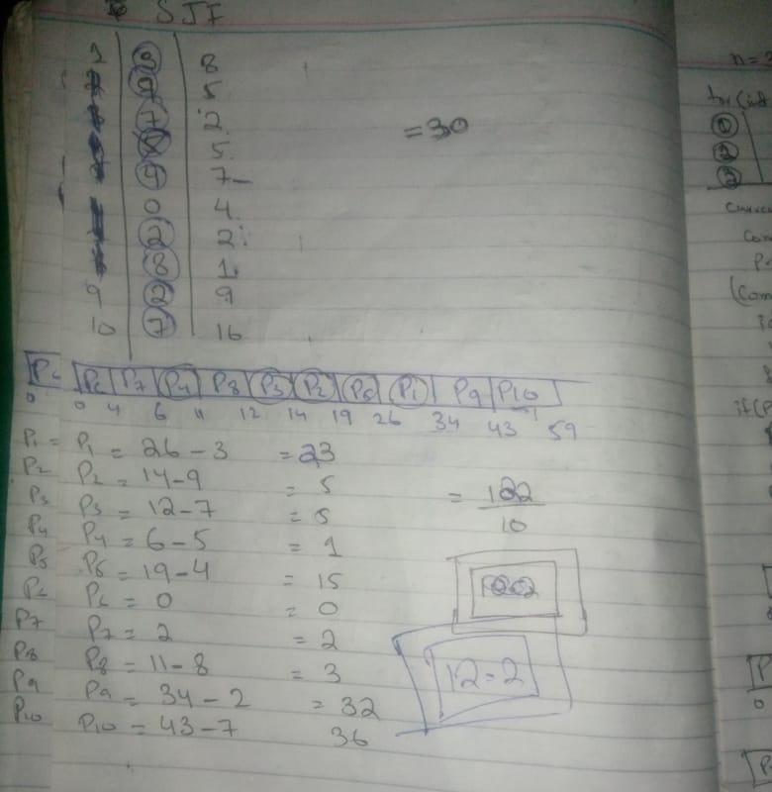
SJF

Slide 12
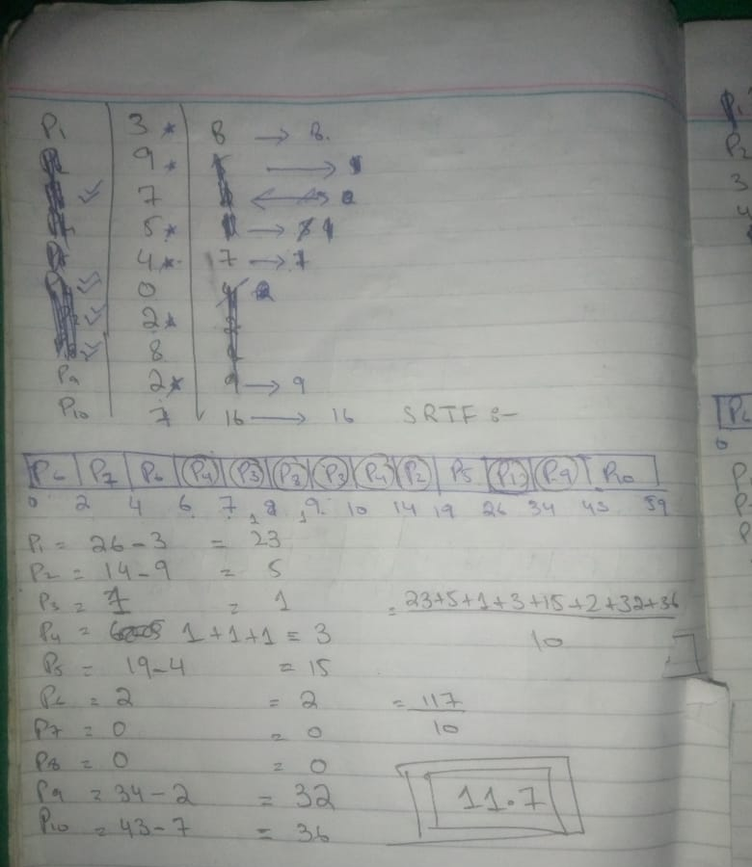
SRTF

Slide 13
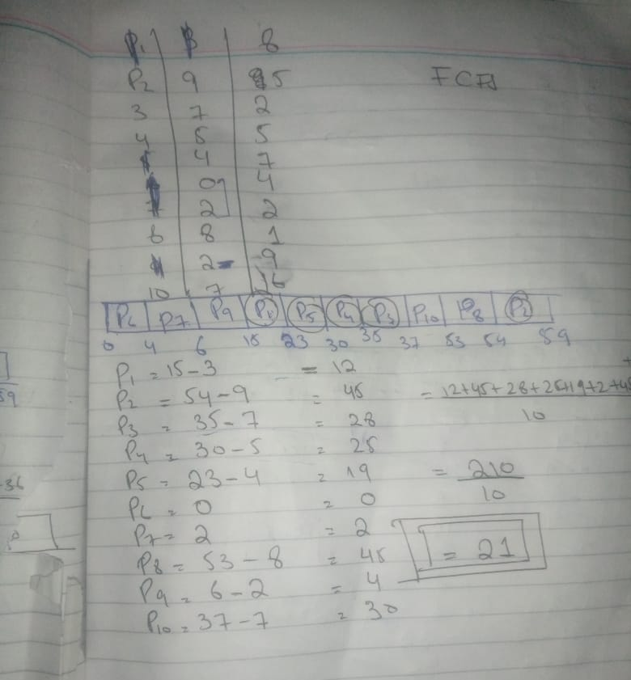
SJF

Slide 14

Thank You!

